Slide 1

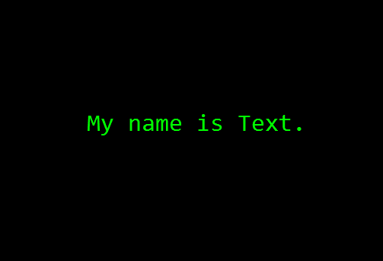
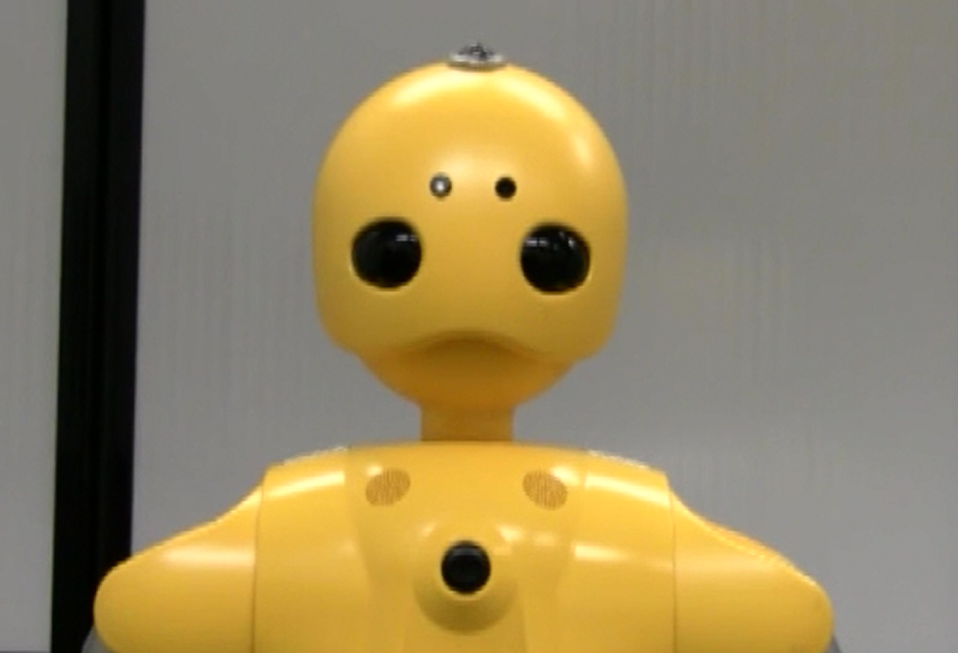
The Effects of Text and Robotic Agents on Deception Detection
Wesley Miller and Michael Seaholm – Department of Computer Sciences
University of Wisconsin – Madison
Research Question
Hypotheses
Results
How does the presence of specific cues for deception, including content-based, linguistic, and physical cues, in messages presented by a human, a robot, and a text-based agent affect people's perceptions of the deceptiveness of the message?
Participants will more reliably detect deception from human agents exhibiting all three cues as compared to the other agents.
Participants will rate text-based agent statements as true more so than with any other agent.
The data indicate that although true responses did not vary significantly across agents, the rating for false statements vary significantly between the human and text-based agents. In particular, the human agent was considered less truthful when giving false statements while the text-based agent was rated as being more truthful when giving false statements.
Experimental Procedure
Our experiment follows a single-factor design with three levels, one for each ordering of agents. Each participant is exposed to only one ordering, meaning that our experiment is between-participants. We had 24 participants in total for this experiment. In accordance with procedure, each agent tells lies at the same rate (30%) and accompanies each lie with a deception cue – either gaze aversion, rapid rate of speech, or blocking access to information.
A plurality of participants (54%) stated that if, in the future, they could interview only one agent with regards to a significant event that had occurred, they would choose the robotic agent.
Interestingly, when asked to give the order in which they would have interviewed all three agents if given the chance, 58% of participants answered that they would interview the human agent first.
1) The participant interacts with a human, a robot, and a text-based agent through a computer interface in a predetermined order.
When asked which agent was the most guilty of the incident discussed in the interviews, most participants (50%) chose the human agent. A breakdown of the participants’ explanations for why they chose to assign guiltiness to each agent the way they did is as follows:
Q: Where were you when the leak occurred?
A: I was on break up in the employee rec room.
Not at all truthful 1 | 2 | 3 | 4 | 5 | 6 | 7 Very truthful
Human | Robot | Text
Humans have the malicious potential to lie and are able to think and act freely, making them more responsible. | Robots do not have feelings, so they do not have an incentive to lie. | The agent has no way of presenting information other than flat text, which is interpreted as being truthful.
2) The participant asks a preset list of questions through a headset and receives answers back. For each answer given, the participant marks down how truthful he or she thinks the statement is.
Human | Robot | Text
✔ | ✔ | ✖
Conclusions
We were correct in our assertion that participants would be able to tell whether the human agent was telling the truth or not with greater accuracy than with the other agents and that the text-based agent would be thought of as the most trustworthy of the three. Additionally, we found that of the cues exhibited by the human agent, the linguistic and content-based cues were most reliably identified by the participants.
3) Once questioning of all three agents is complete, the participant marks down how trustworthy he or she thinks each agent is.

